Slide 1
PROJECT REPORT
For IUIT
By Team-Code Crusaders

Slide 2
INTRODUCTION
Modern kitchen gadgets have transformed the traditional kitchen.
AI technology is being integrated into kitchens for enhanced convenience and safety.
AI-enabled kitchens offer advantages over traditional kitchens by handling repetitive tasks and preventing accidents.

Slide 3
PROBLEM STATEMENT
In our new world , demand of personalization and efficiency has increased .Now traditional kitchen appliances lacks of intelligence to meet needs of different kind of people. This shows a necessity for an advanced AI kitchen system for user convenience ,resource management etc. On-going kitchen technologies often fails to offer:
Personalization
Enery Consumption
Intelligent Assistance
Data Utilization
Scalability

Slide 4
Addressing these challenges arises requirement of development of customized AI kitchen system that incorporates machine learning ,IoT connectivity and intuitive user interfaces. This system should enable seamless communication among kitchen appliances,
provide personalized cooking recommendations ,optimize resource usage and empower users to create culinary experiences to their unique tastes and dietary requirements

Slide 5

SOLUTION

Slide 6
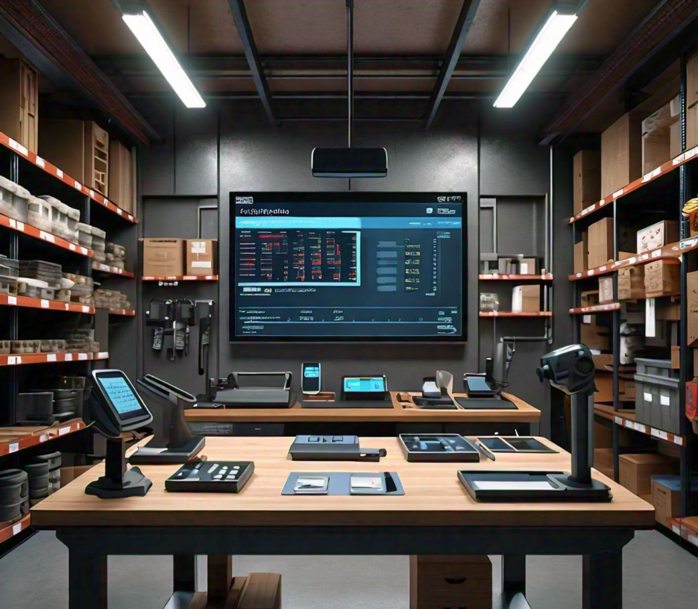
SMART INVENTORY

Slide 7
SMART INVENTORY
Creating a customized AI-driven smart inventory system for a kitchen involves several key components and functionalities.
FEATURES
Item management
Threshold alerts
Reporting and Analytics
Shopping list generation
Smart labeling
Air and temperature sensing

Slide 8
TEMPERATURE SENSORS
Temperature maintenance involves the use of temperature sensors to monitor the temperature. If the temperature goes out of the specified range, an alert is sent to the user, and control is enabled through methods such as ventilation, air supply, and temperature controllers. For instance, in a cold room designed for storing meat, the temperature is typically maintained between -18 to -23°C. If the temperature deviates from this range, an alert is sent to the manager, and the refrigeration system works to bring the temperature back to the desired range.

Slide 9
AIR QUALITY MANAGEMENT SYSTEM
The Air Quality Management System described integrates smart sensors in kitchen appliances to monitor VOCs, CO2 levels, and particulate matter. It enables real-time monitoring and data collection, processed by AI algorithms for accurate air quality assessment. Integration with smart home systems optimizes air circulation, while user-friendly interfaces allow for monitoring, alerts, and personalized adjustments. The system employs a feedback mechanism where gas sensors activate, monitor emissions, initiate purification if harmful levels exceed thresholds, and continue looping until safe levels are achieved, ensuring continuous air quality control.

Slide 10
REPORTING AND ANALYTICS
It determines the quantity left of each ingredient and display the information. It also tracks the usage of items over time by continuously measuring and logging the amount of each ingredient into a database at fixed intervals. This data is analyzed to track usage over time and display reports on seasonal trends. It analyzes the cost and usage of materials, storing the data in a database, and calculate the total expenditure over a specified period. Lastly, it tracks the amount of food wastage, maintaining a report on food that has gone bad or expired. Using this data, we can identify which ingredients are frequently wasted due to spoilage or expiration, and display the most wasted food.

Slide 11
SHOPPING LIST GENERATION
The process for integrating online shopping with inventory management starts with regularly checking inventory levels and identifying items that are low in stock. A shopping list is then generated based on these inventory levels and user preferences. Users can review and modify this list if needed. Upon approval, users select a grocery delivery service, and the system places the order. Once the order is confirmed, users receive an order confirmation and the system tracks the delivery status. After receiving the grocery delivery, the inventory levels are updated accordingly.

Slide 12
SMART LABELING
Effectively organizing inventory involves several key steps. First, categorize items by grouping similar ones together based on type, use, or other relevant criteria. Next, ensure clear and consistent labeling for each category or item to facilitate easy location. Implementing a suitable inventory management system, such as FIFO or LIFO, is crucial to meet specific operational needs. Regular audits, including scheduled physical counts and reconciliations, help maintain accuracy and address any discrepancies promptly. Lastly, optimize storage by arranging items to maximize both space efficiency and accessibility, ensuring a streamlined inventory management process.

Slide 13
ITEM MANAGEMENT
Add, update, and remove items: Users can manage inventory by adding new items with details, updating existing item information, and removing unnecessary items.
Categorize items by type: Items are categorized into perishable, non-perishable, and beverages to streamline management.
Track item details: The system tracks quantities, expiration dates, and storage locations of items.

Slide 14
THRESHOLD ALERTS
Set stock thresholds: Users can set minimum stock levels for items to trigger alerts when inventory is low.
Expiration notifications: The system generates alerts for items nearing or past expiration dates to prevent wastage and maintain freshness.

Slide 15
TECHNOLOGIES USED
The technologies used here are :
Tkinter: Tkinter is the primary technology used for creating the graphical user interface. It provides the necessary widgets and functionalities for developing the GUI application .
Python: The entire script is written in Python, making use of its syntax, built-in functions, and object-oriented programming concepts to create the application.
Python Dictionary (dic): A Python dictionary is used to store the items and their corresponding quantities, effectively managing the data and performing operations like addition and subtraction of quantities .
Error Handling with try-except Blocks: The script makes use of Python's built-in error handling mechanism using try-except blocks to handle potential exceptions, particularly managing input validation for numbers .
Widget Rendering and User Interface Management: The native rendering of visual elements and user interface management is provided by Tkinter, allowing the application's components to seamlessly integrate with the underlying operating system rendering components, thereby ensuring that the GUI elements look and feel native to the platform where they're run

Slide 16
GUI Layout Managers - Pack, Grid, and Place: The script leverages Tkinter's layout managers to organize and position the widgets within the GUI application. It uses the pack and grid layout managers to arrange the widgets on the window using different grid and packing methods
These underlying technologies work collaboratively to ensure the successful execution and user interaction capabilities of the GUI application
Sensors : Sensors can be used in this execution which is used to measure quantities of materials and with the use of sensors the accessibility can be more efficient and the process is made more simple.
Touchscreen Displays: Touchscreens are common in devices like smartphones, tablets, and information kiosks. They enable direct interaction with the graphical user interface through touch gestures, allowing users to navigate and interact with the application
RFID Readers: Radio-Frequency Identification (RFID) readers can be integrated into GUI applications for tracking and managing inventory, assets, or access control systems.
These physical technologies would typically interface with the software through appropriate APIs, drivers, or libraries to enable seamless integration with the GUI application.

Slide 17
PROCESS FLOWS

Slide 18
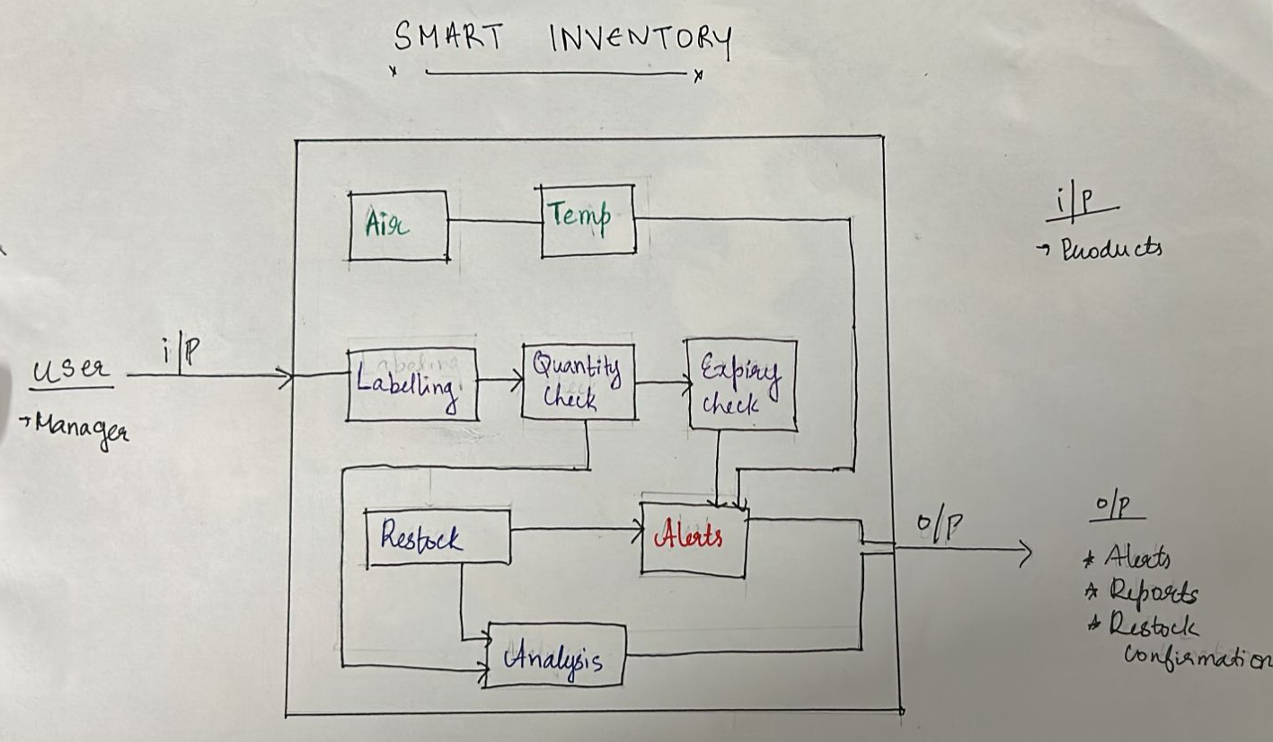
Overall Flow

Slide 19
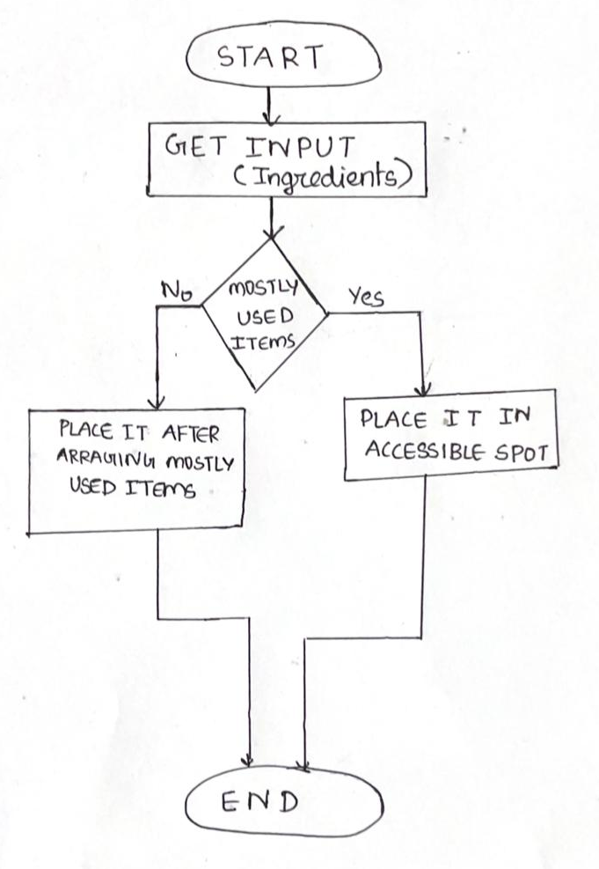
Smart Labeling

Slide 20
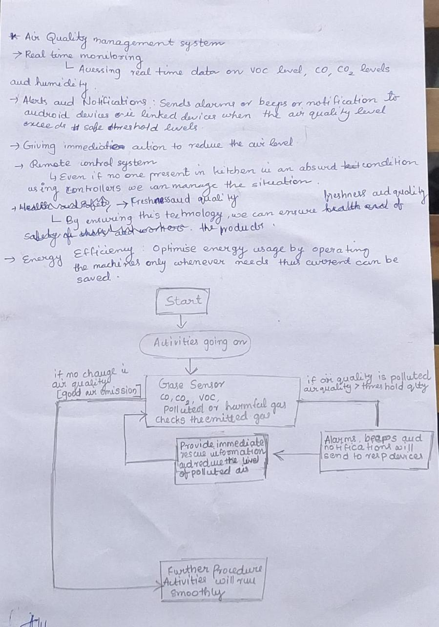
Air Quality Management System

Slide 21
CONCLUSION
The smart inventory system aims to revolutionize kitchen management by integrating online shopping with real-time inventory tracking. It involves regular checks of inventory levels, identifying low-stock items, and generating shopping lists based on user preferences. Users can review and modify these lists, select a grocery delivery service, and have the system place the order. Delivery tracking and inventory updates further streamline the process. Despite challenges in ensuring tracking accuracy, seamless integration with various devices, and scalability to different kitchen sizes, the system promises significant benefits. These include reduced food waste and enhanced convenience, making kitchen management more efficient and user-friendly.

Slide 22
The code and output of the project is available in the GitHub link.
The code can be improved by using more tools.
We thank our mentor Dr.Tessy Mathew for helping us to do this project.

Slide 23
THANK YOU
MEMBERS:
Devika S H
Dinta B Varghese
Varsha Mariyam Biju
Sona Darshan
Mythili Biju

